Slide 1
Distributed Software Development
13-10-23
<numero>

Slide 2

The Development Group
Real-Time Bridge Monitoring
Project Vision
13-10-23
<numero>

Slide 3
Overview
Team Organization
  The Development Group
  Roles and Responsabilities
  Team Communication
System description
  Real-Time Bridge Monitoring System
  Functionalities
Architecture and Technologies
13-10-23
<numero>

Slide 4
Overview
Project Plan
  20/10 – 23/11
  24/11 – 28/12
  29/11 – 13/01
Risks
Question time
13-10-23
<numero>

Slide 5







Team Organization
The Development Group
Andrea Bottoli (PoliMi) Lorenzo Pagliari (PoliMi) Marko Brčić (FER)
Dzana Kujan (MDH) Jörn Tillmanns (MDH) Miraldi Fifo (MDH) Nikola Radisavljevic (MDH)
13-10-23
<numero>

Slide 6
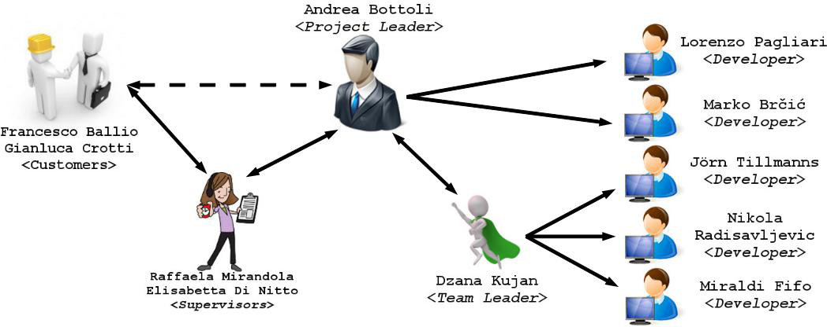
Team Organization
Roles and Responsabilities
13-10-23
<numero>

Slide 7




Team Organization
Communication
13-10-23
<numero>

Slide 8
System Description
Real-Time Bridge Monitoring
  People must take decisions during crisis
  Based on confident data from math formulas
    Bridge condition
    Structural damage
    Stresses
  Store historical data to make some statistics
  Show data on local and remote UI
  User friendly UI
13-10-23
<numero>

Slide 9
System Description
Functionalities (I)
  Gather sensors's informations
    Anemometer: wind speed
    Hydrometer: water level
    Echo sounder: river bed depth
    Cam: pillars pictures
  Store informations into a DB
    Current data
    Historical data
13-10-23
<numero>

Slide 10
System Description
Functionalities (II)
  Make calculations on the data
    Structural calculations, stresses, ...
  Display data to users
  Alert the users (pop up, e-mails, ...)
    Green: “ok, it's good”
    Yellow: “wait a moment...something's wrong”
    Red: “ALARM, bridge is crashing down!!!!”
  Personalize bounds, views, ...
13-10-23
<numero>

Slide 11
System Description
Functionalities (III)
  Graphs and statistics (with personalizations)
    Display and browsing temporal trends
    ...the flood is increasing his speed...
    ...the wind is changing speed...
    ...last year when X happened, Y happened...
  Web Services
    Remote users could use the system functionalities
    Tablets, Smartphones, ...
13-10-23
<numero>

Slide 12
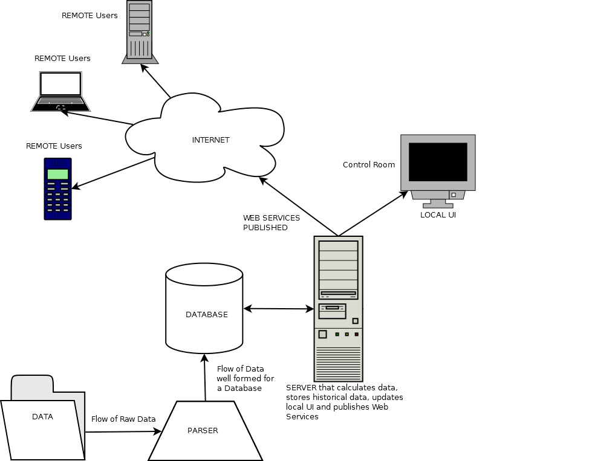
Architecture
13-10-23
<numero>

Slide 13
Architecture
Python
13-10-23
<numero>

Slide 14
Architecture
MySQL
Python
13-10-23
<numero>

Slide 15
Architecture
Java & Java Servlets
MySQL
Python
13-10-23
<numero>

Slide 16
Architecture
HTML
Java & Java Servlets
MySQL
Python
13-10-23
<numero>

Slide 17
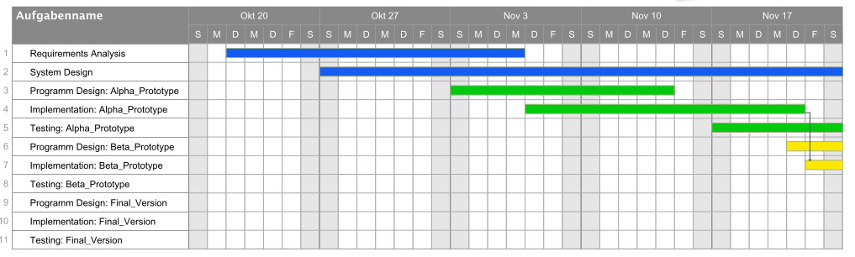
Project Plan
20/10 – 23/11
13-10-23
<numero>

Slide 18

Project Plan
24/11 – 28/12
13-10-23
<numero>

Slide 19
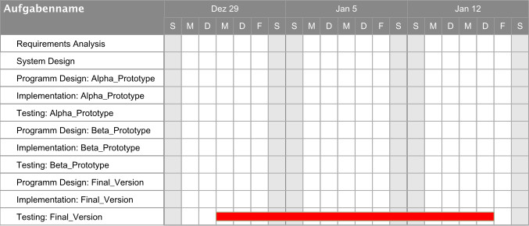
Project Plan
29/11 – 13/01
13-10-23
<numero>

Slide 20
Risks
Communication
  Within distributed groups (SWE, ITA, CRO)
  Within the team
  With customers
Still unknown input data and data format
Incomplete requirements
13-10-23
<numero>

Slide 21

Question Time
13-10-23
<numero>

Slide 22

Thank You
Thank you for your attention :-)
13-10-23
<numero>

